Slide 1

ITP 259: Basics of Artificial Intelligence Fall 2024 Lecture 4: Dataframes
Dr. Martin Prescher Information technology Program
Viterbi school of engineering

Slide 2
“Can you prove you're self-aware?"
- Transcendence

Slide 3
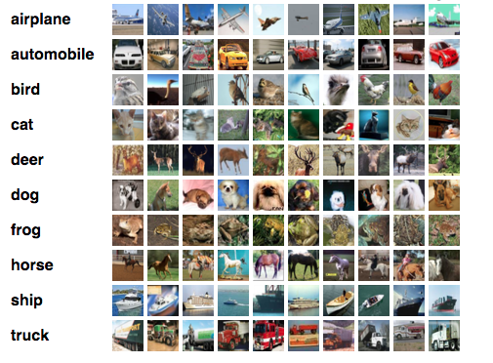
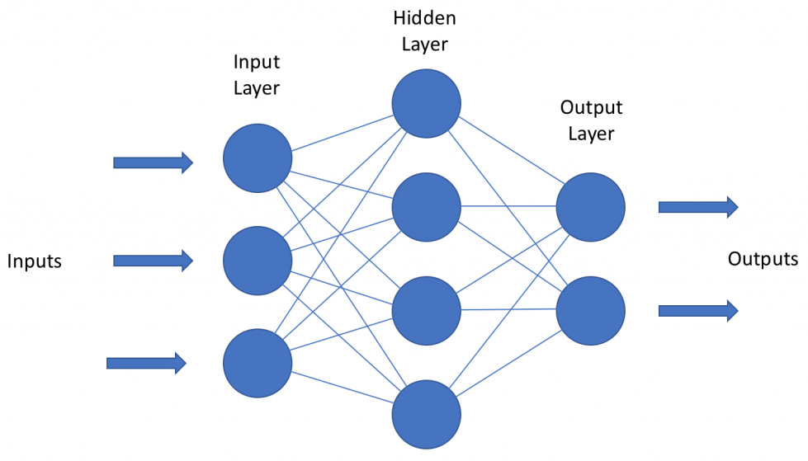

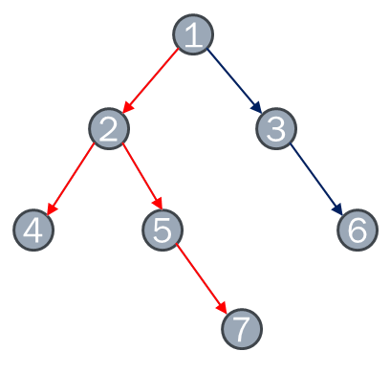
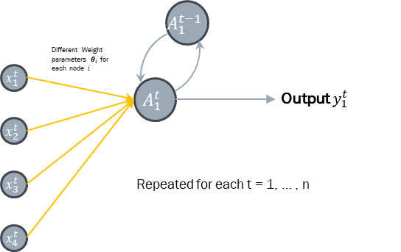
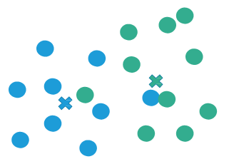
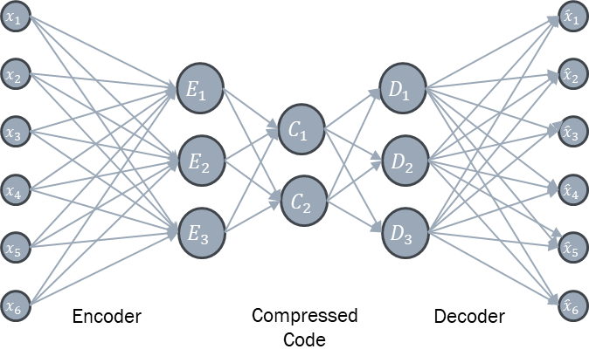
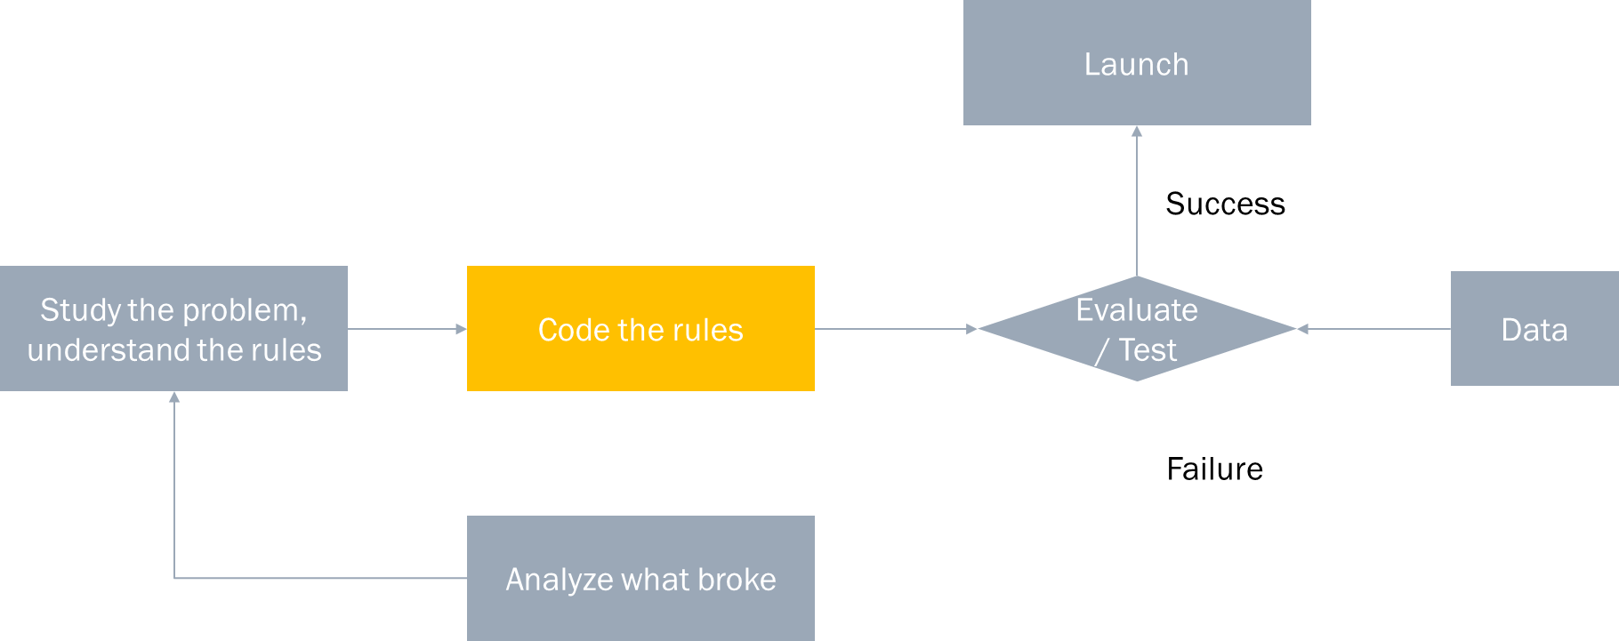
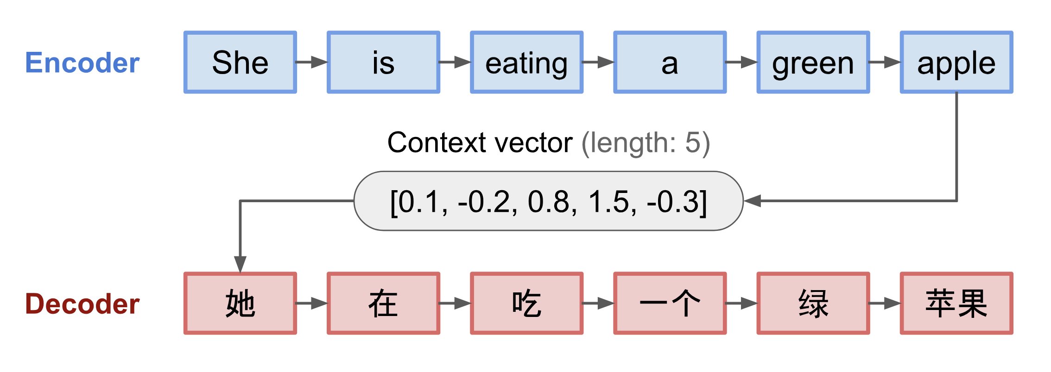
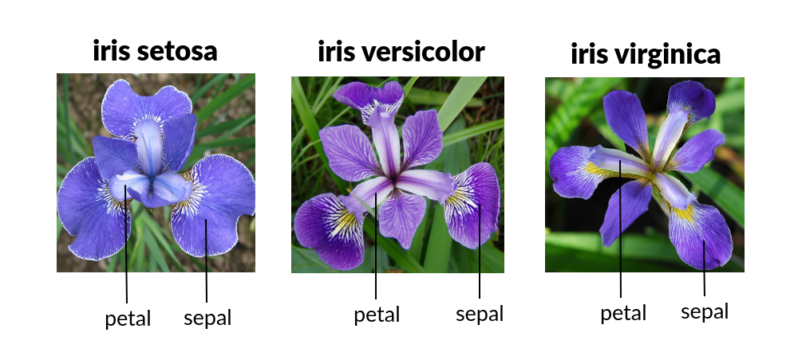
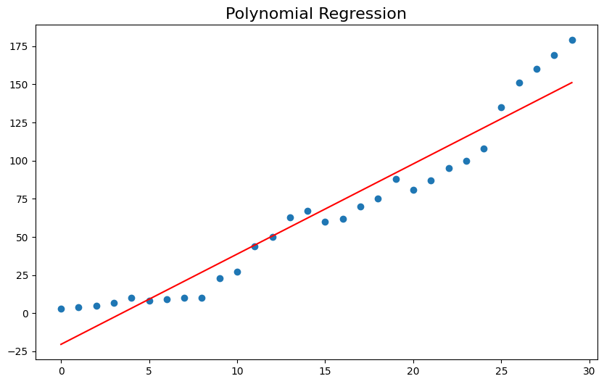
Recap!
Overview of AI Approaches
Heuristics
Symbolic
Search
(discrete spaces)
Machine Learning
Unsupervised
Artificial Neural Network
CNN
RNN
LSTM
Autoencoders
Transformers
Regression
Classification
Support Vector Machines SVM
Markov process
Bayesian
Logical inference
Knowledge representation
Rule-based
Game playing
Expert Systems
Fuzzy Logic
Ontologies
Semantic web
Supervised
Statistical
Reinforcement learning
Clustering
Association
Dimension Reduction (e.g. PCA)
GAN
Informed (Heuristic) Search
Minmax Search (can be heuristic search)
A* Search
Simulated Annealing
Traveling Salesman e.g. Dijkstra)
Uniform Cost
Local Search
Hill Climbing
Best-First (Greedy) Search
Breadth First (BFS)
Tabu Search
Uninformed (Brute Force) Search
Depth First (DFS)
Genetic Algorithms
For these algorithms you don’t have to supply a heuristics function
These search techniques do not follow any higher-level goals

Slide 4
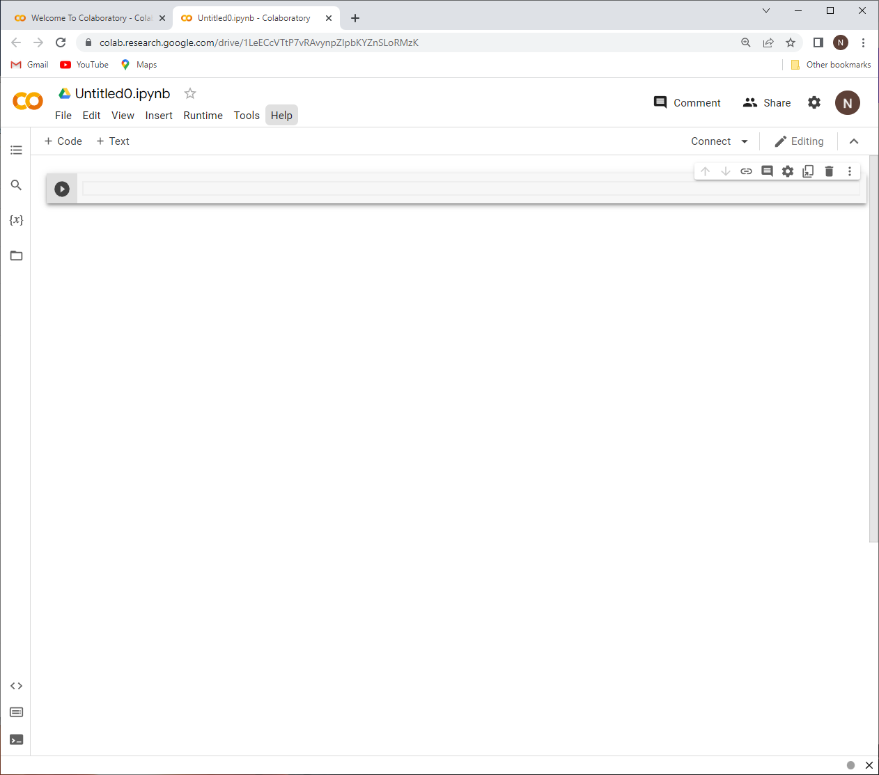
What is Google Colab?
See separate slide deck on BB on Colab
Google Colaboratory
Cloud based Jupyter notebook coding environment by Google
Alternative to pycharm
Code, comment, describe, execute and visualize your AI programs online
Basic version is free (with some limitations)
Integration with Google Drive, GitHub
Easy to use, save, share
Many Python libraries are pre-installed

Slide 5

See separate slide deck on BB on Colab
https://www.jetbrains.com/pycharm/

Slide 6
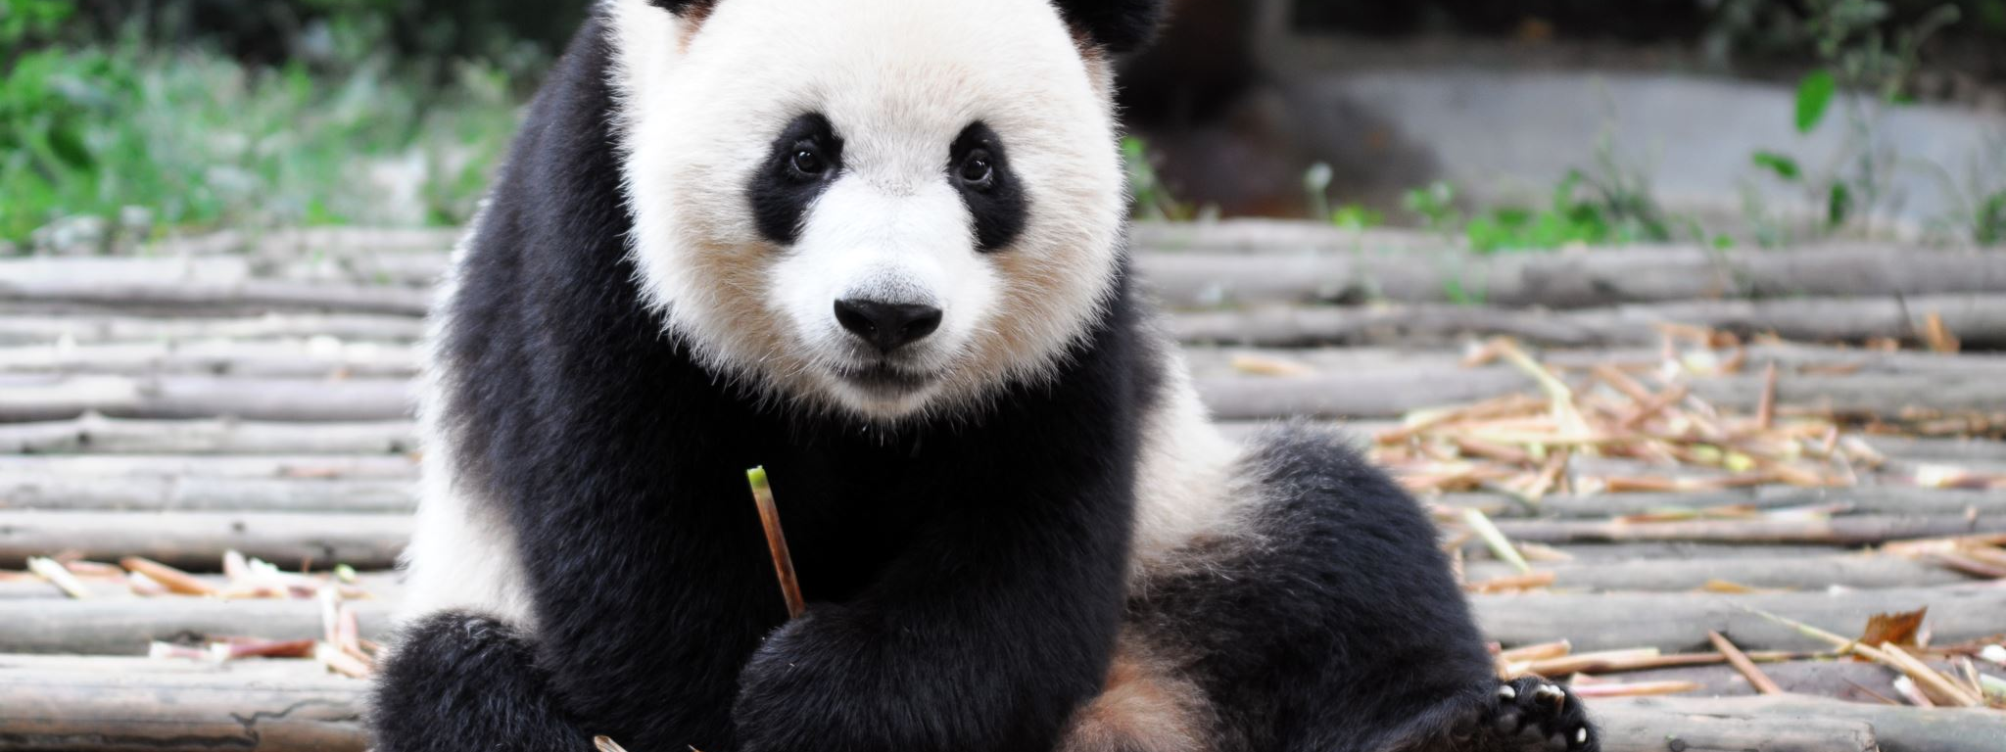
Pandas
Notes:
Data structures and manipulation
Extends numpy

Slide 7
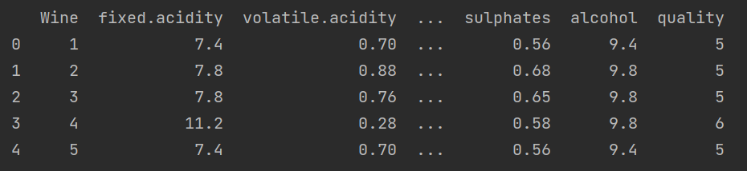
Pandas – Why are we using this?
Contains data structures and data manipulation tools designed to make data cleansing and analysis fast and easy
Dataframes within Panda are perfect to store, manipulate, and visualize large datasets, e.g. large .csv / Excel files
Adopts coding style from Numpy but main difference is that Pandas handles heterogeneous data
Notes:
Open source started in 2010
Has over 800 devs

Slide 8
Pandas – What can they do?
Data Manipulation: moving columns, slicing, reshaping, merging, joining, filtering, and others.
Summary Statistics: Fast and powerful summary statistics of data.
Visualization: Simplified access to plots on data structures, such as histograms, box plots, general plots and a scatter matrix.
Time-series Handling: operations on date/times, resampling, moving windows and auto-alignment of datasets.
Missing Data Handling: auto-exclude, drop, replace, interpolate missing values
Group-by Operations: SQL like group by.
Hierarchical Indexing: data structure level, powerful for efficiently organizing data by columns.
Notes:
Open source started in 2010
Has over 800 devs

Slide 9
Series
A one-dimensional object similar to an array, list, or column in table.
Each item in a Series, however, is assigned to an entry in an index. Think an Excel-file: each row has an index label – the same for a Series.
Lets have a look in Colab / PyCharm.

Slide 10
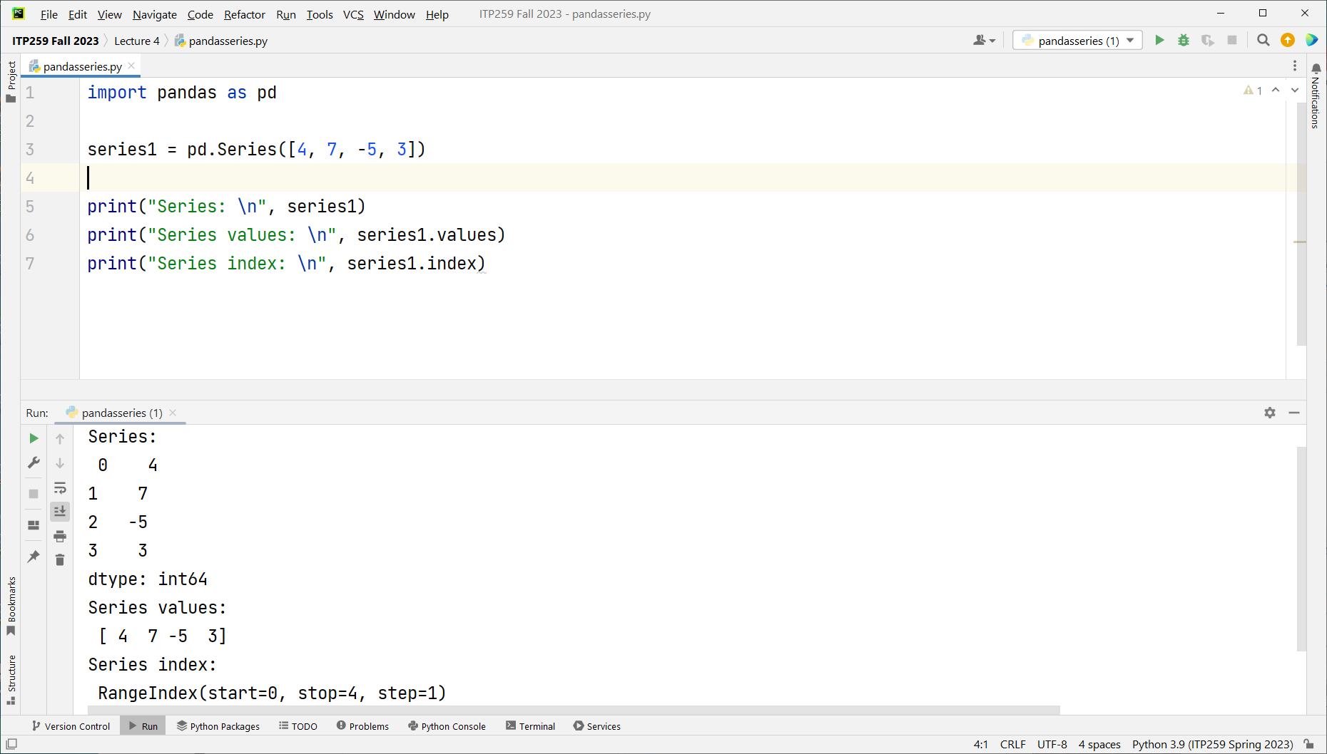
Index is a range

Slide 11
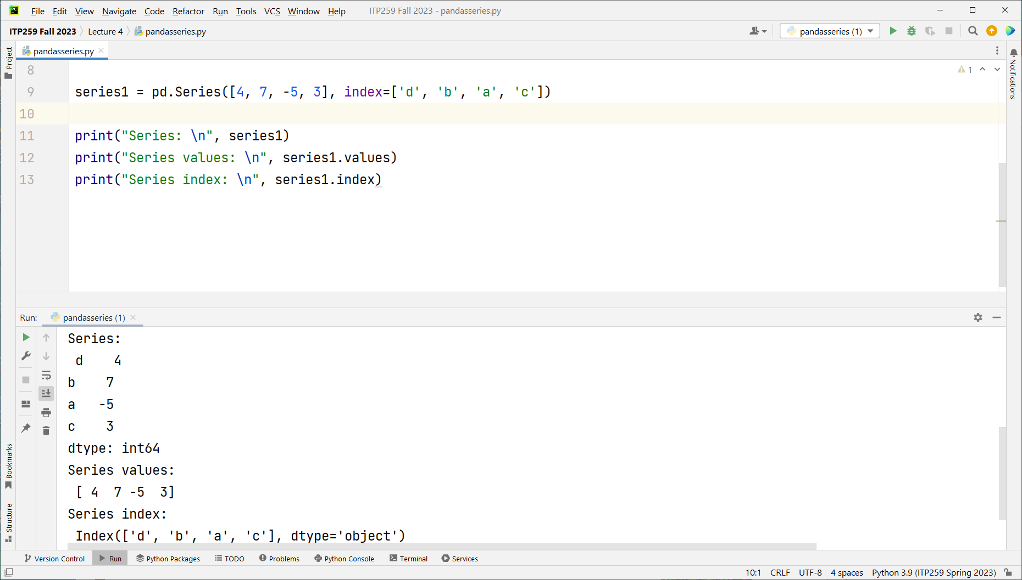
Index is an object

Slide 12
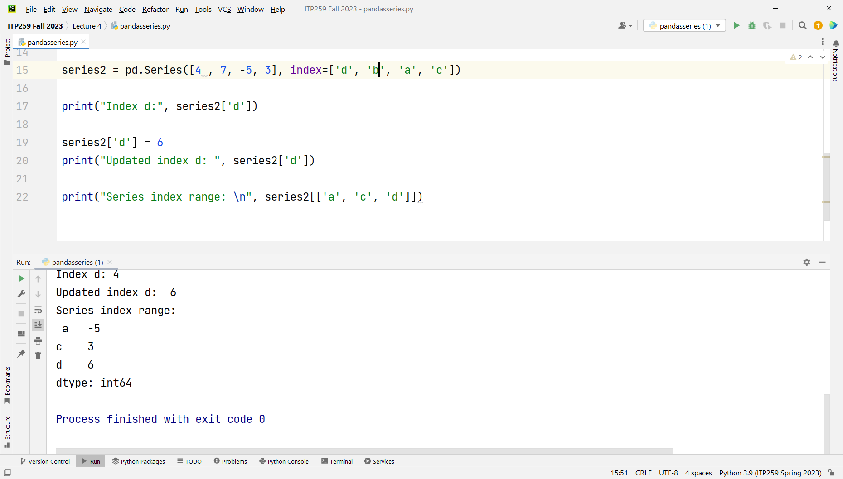
Series with an index range.
Provide index to the series to filter.

Slide 13
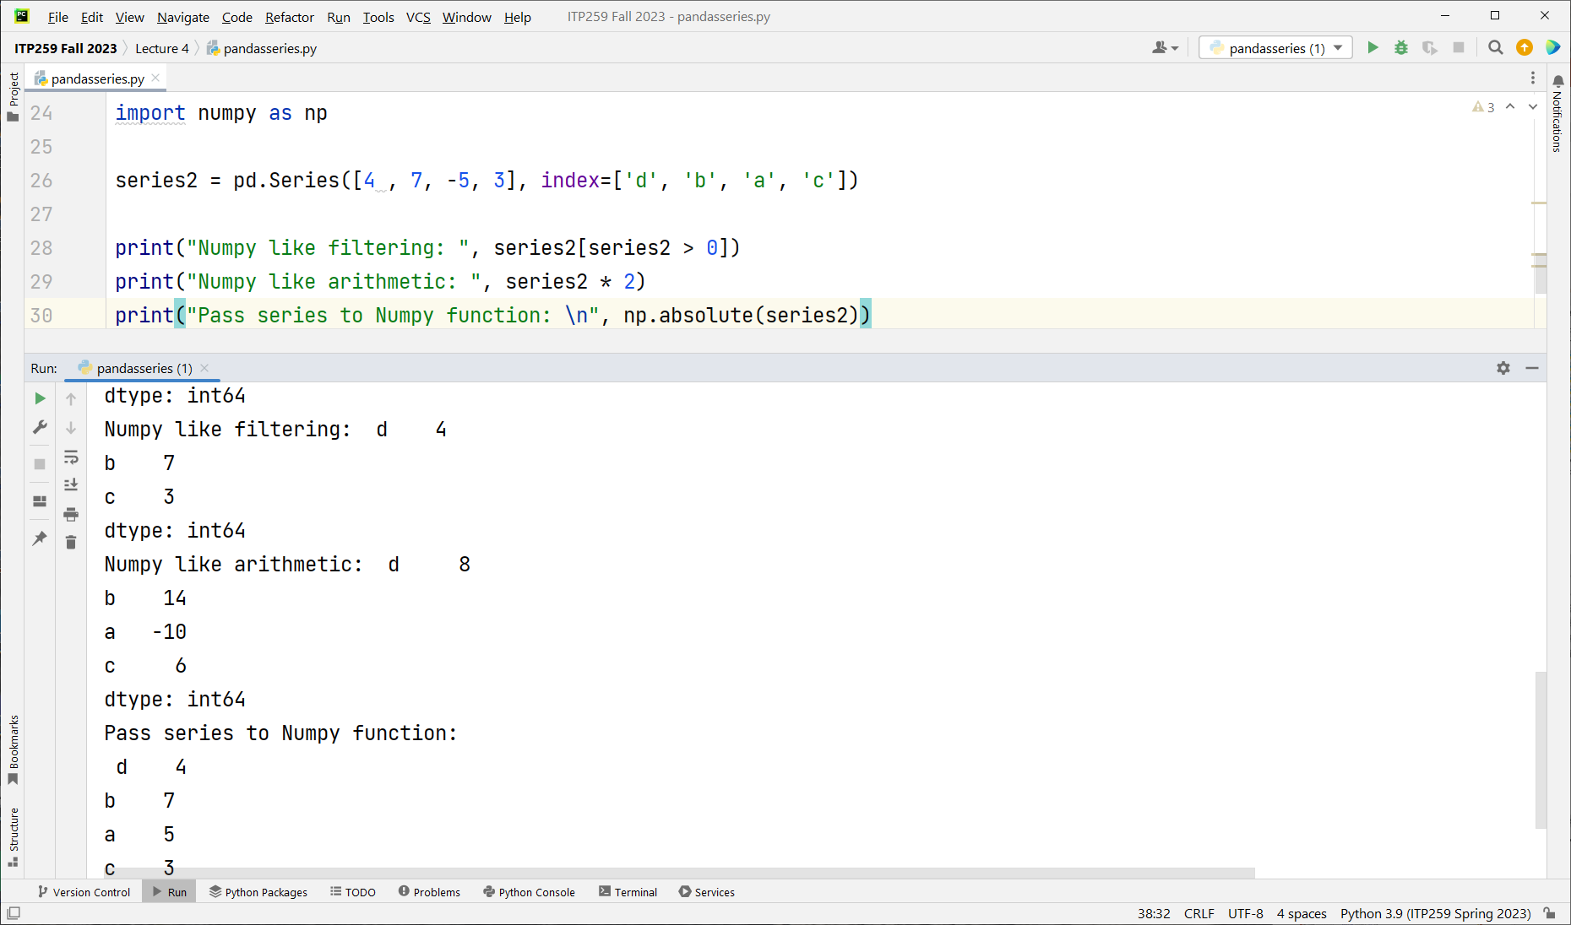

Slide 14
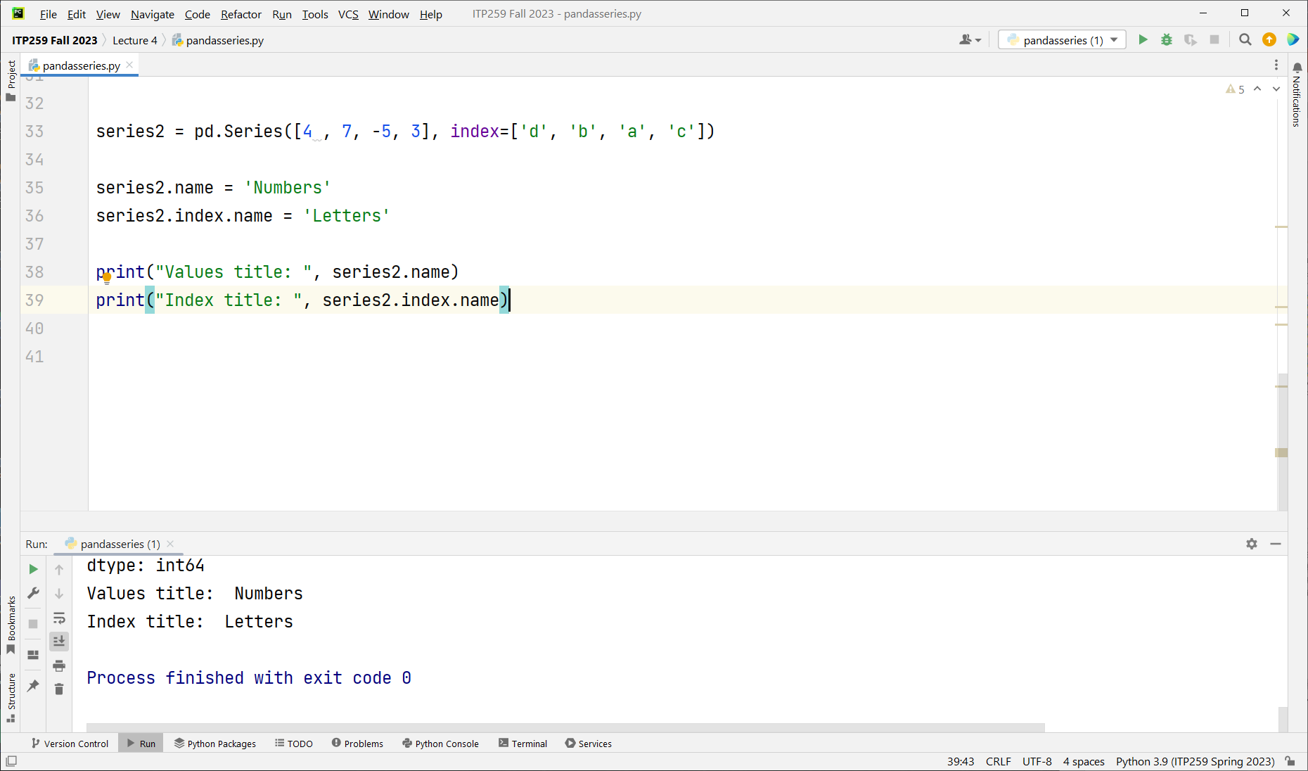
Name Index column and series values.

Slide 15
DataFrame
Represents a rectangular table of data (2D) and contains an ordered collection of columns, each of which can be a different value type (numeric, string, boolean, etc.).
Has both a row and column index.
Why a DataFrame? For machine learning we usually have a collection of numeric and/or categorical predictor variables (factors, features) and a numeric or categorical target variable.
Index | Factor / Feature 1 | Factor / Feature 3 | Factor / Feature 3 | … | Target (value / category)
0 | Values (floats, strings,…) | … | … | … | Values (floats) or categories (e.g. strings, bool, bins)
1 | … | … | … | … | …
2 | … | … | … |  | …
… | … | … | … | … | …

Slide 16
Creating Data Frames

Slide 17
Columns
We will load data mostly from csv files into dataframes (for machine learning).
Dataframes can be created from lists, dictionaries, dataframes, series, 2D arrays
You can optionally specify row labels and column labels
If no labels are set, then the rows and columns are labeled 0, 1,…
 | State | Year | Pop
0 | Ohio | 2001 | 1.7
1 | Ohio | 2002 | 3.6
2 | Nevada | 2003 | 2.4
3 | Nevada | 2004 | 2.9
4 | Nevada | 2005 | 3.2
Rows

Slide 18
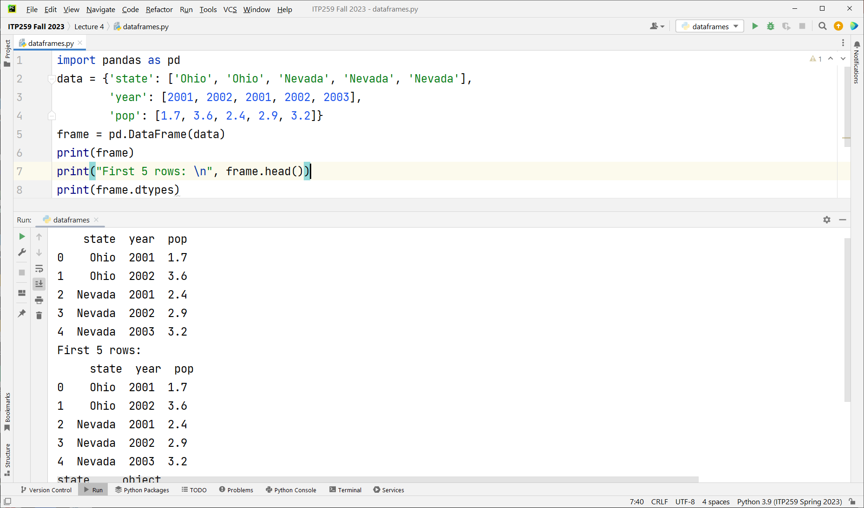
DataFrame from dictionary
Notes:
{ } defines dictionary

Slide 19
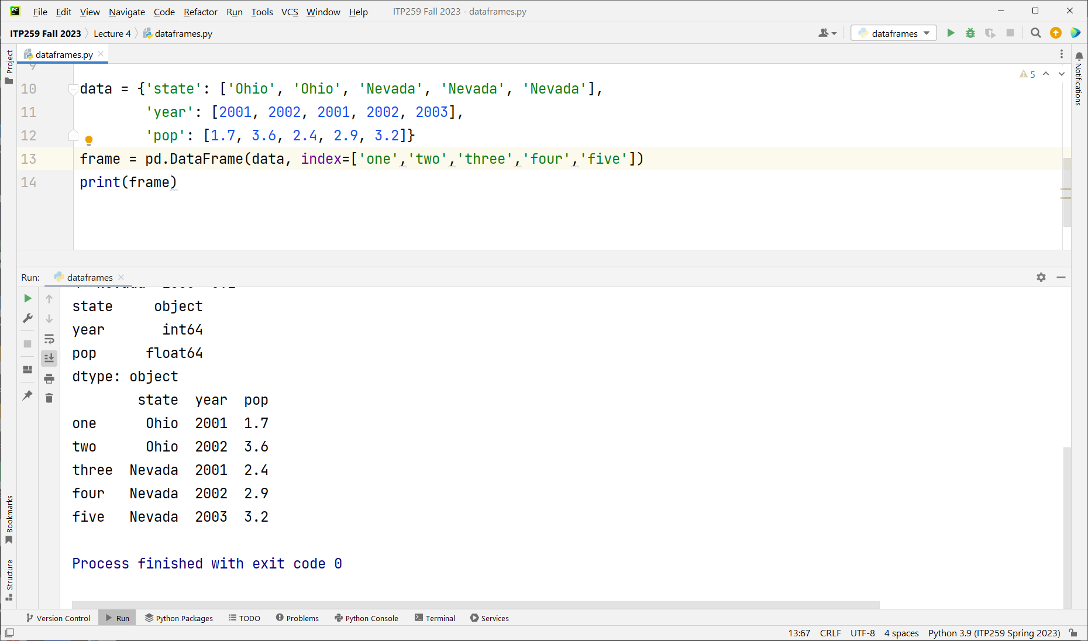
Rename the index

Slide 20
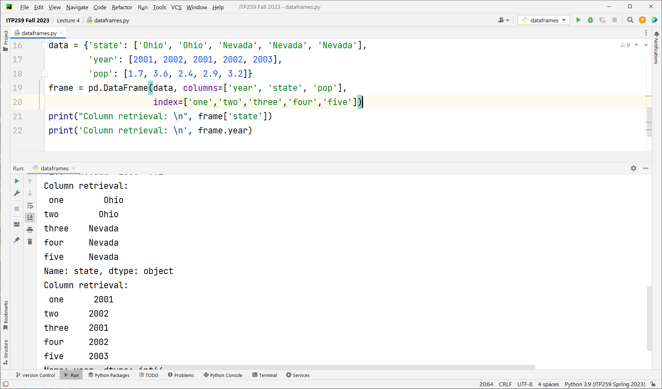
DataFrames come with a type structure

Slide 21
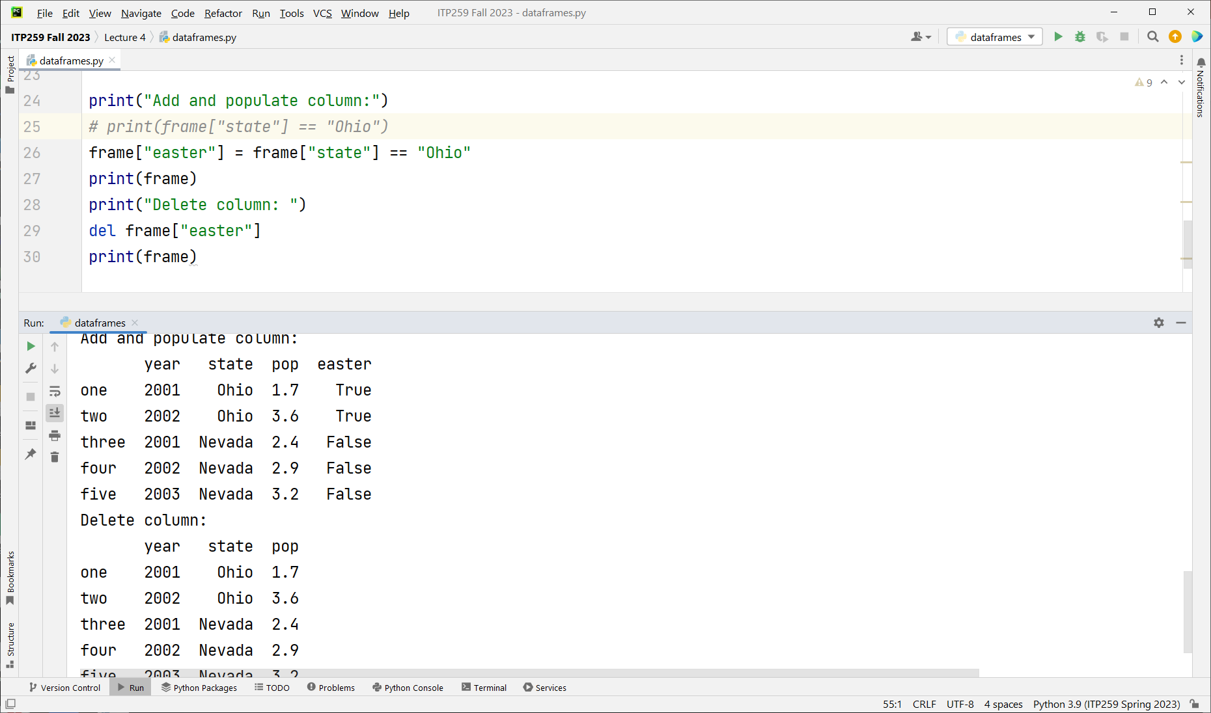
This returns a Bool
Easier to read if put in brackets

Slide 22
DataFrame Indexing
Selecting specific rows and columns

Slide 23
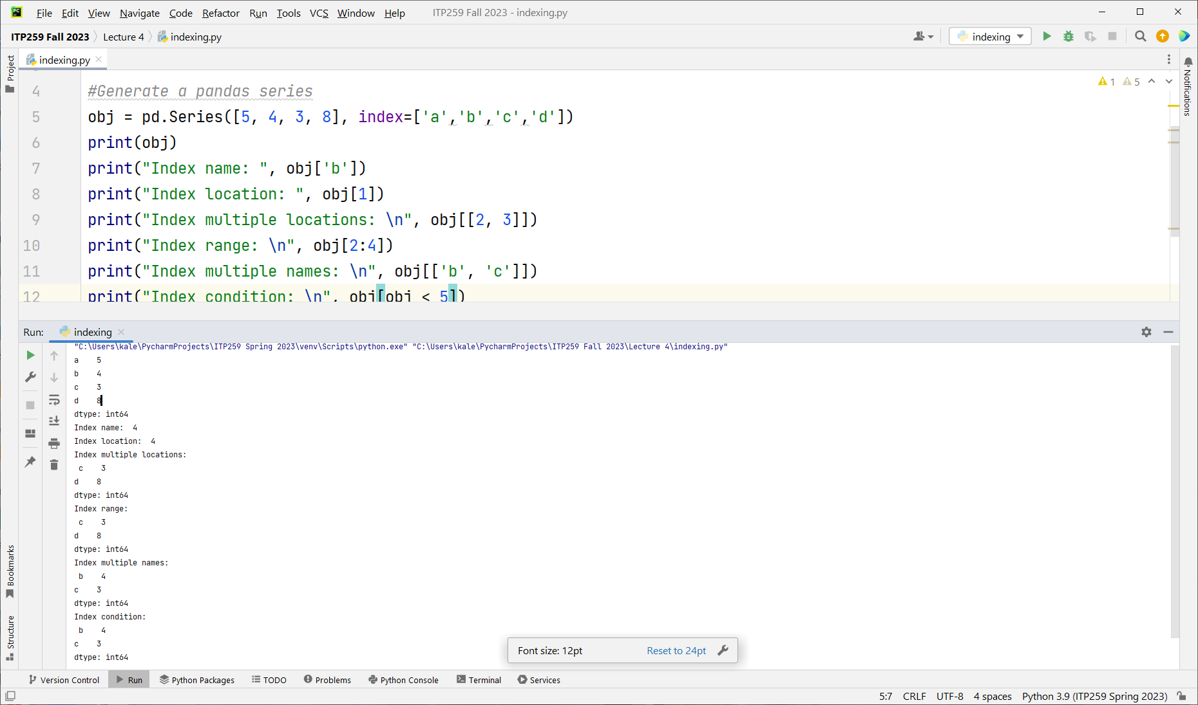

Slide 24
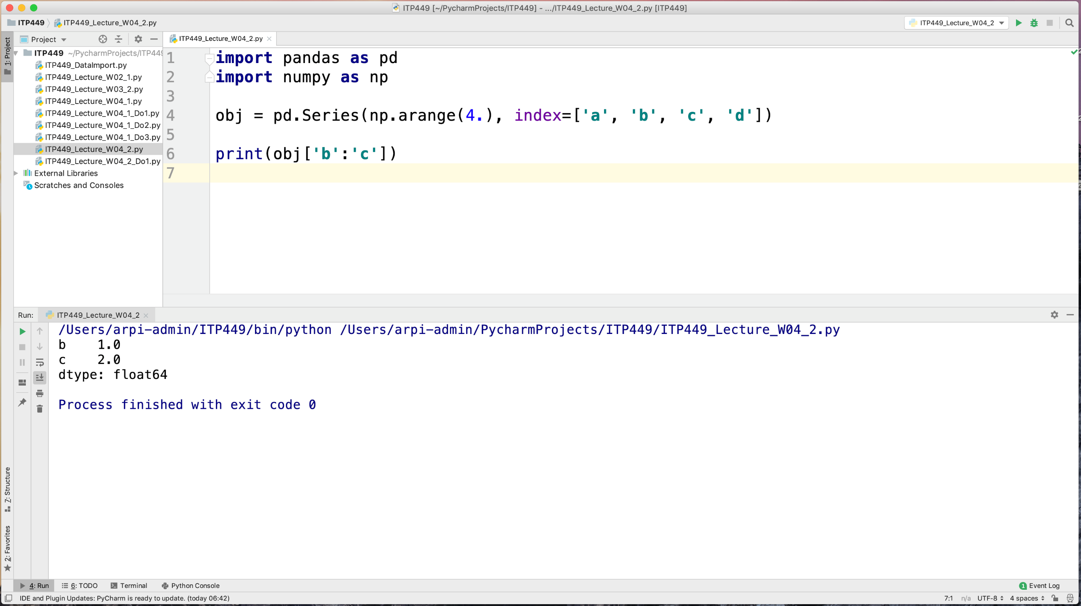
Notes:
Endpoint inclusive

Slide 25
INDEXING
Operation | Syntax | Results in a
Select column | frame[col] | Series
Select row by label | frame.loc[label] | Series
Select row by integer location | frame.iloc[loc] | Series
Slice rows | frame[5:10] | DataFrame
Select rows by boolean vector | frame[bool_vec] | DataFrame
print(data.index)
print(data.columns)

Slide 26
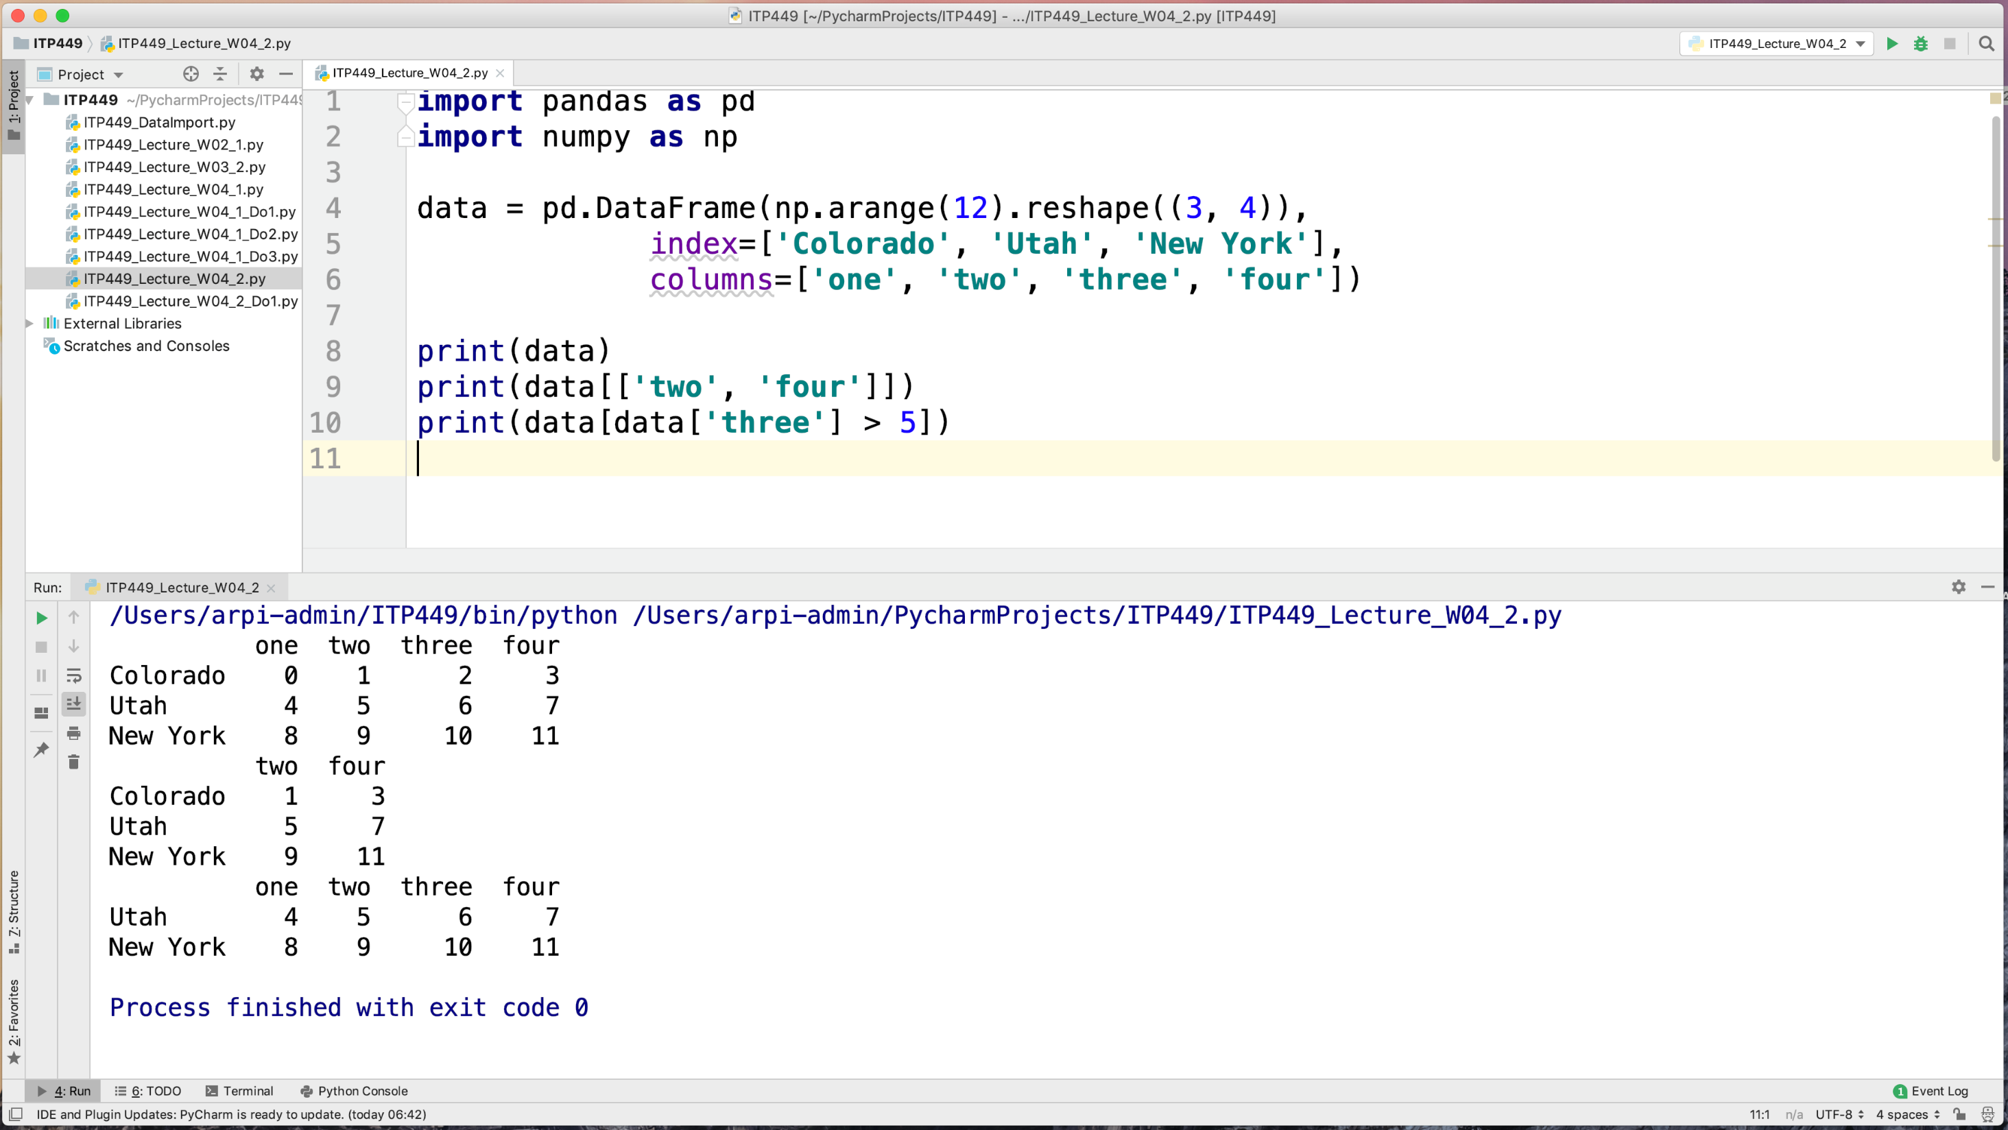
reshape c
Notes:
Only applies to column indexing

Slide 27
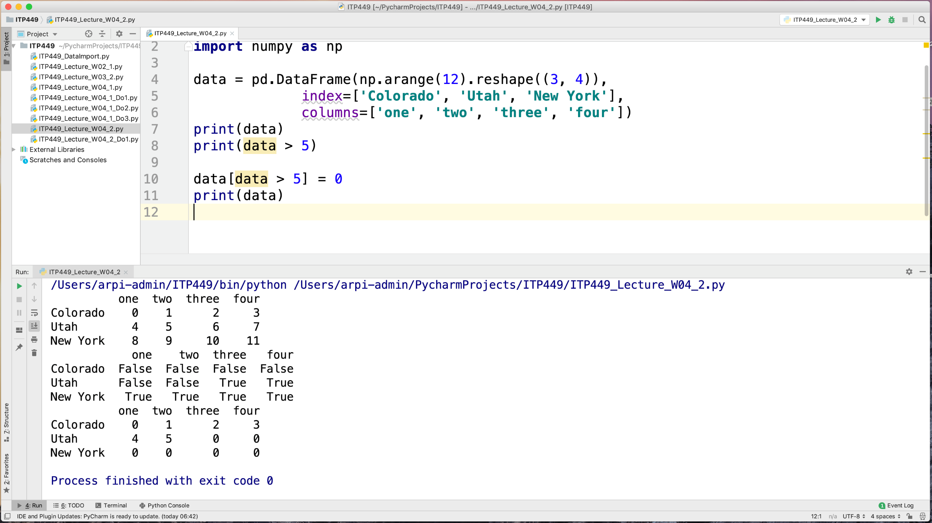

Slide 28
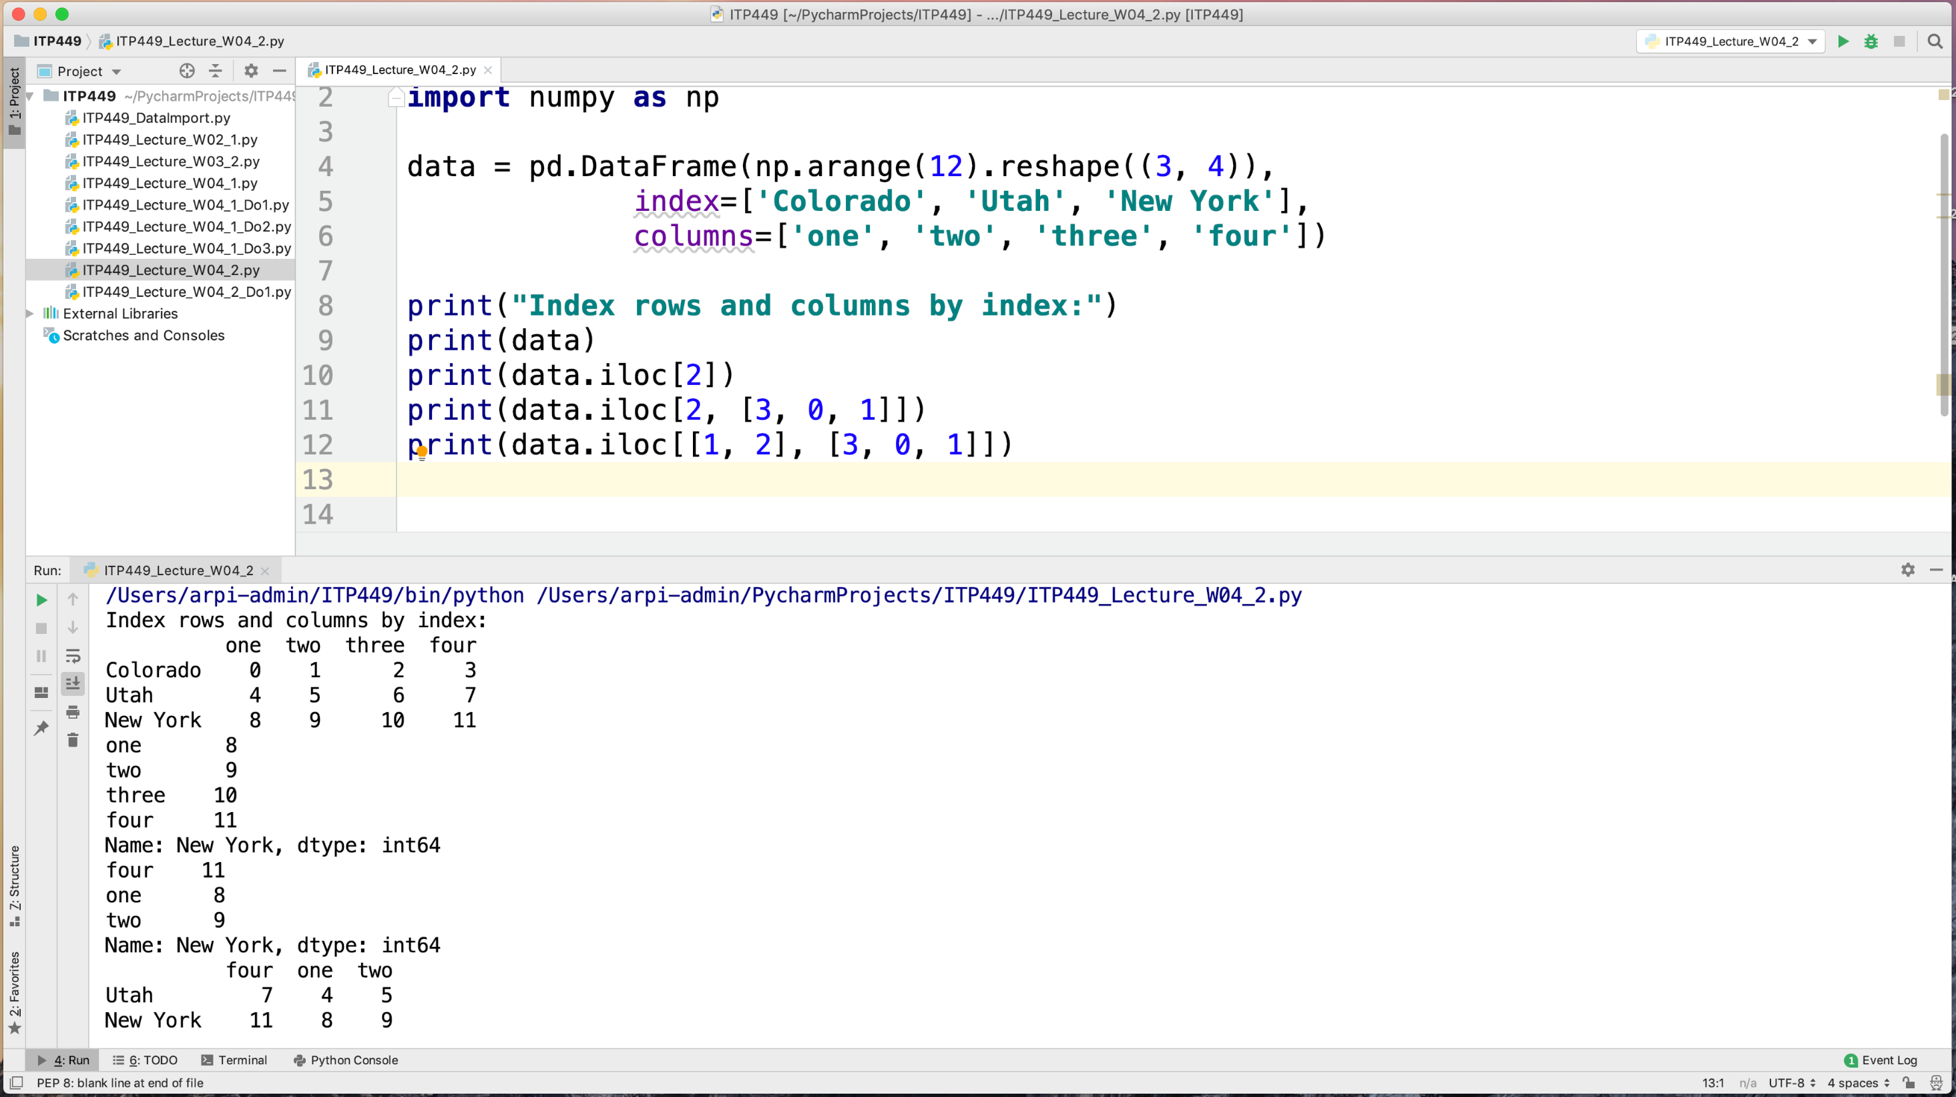
iloc is integer location index
Used for integer based indexing
Use : to display all rows/columns
Data.iloc[:,:]

Slide 29
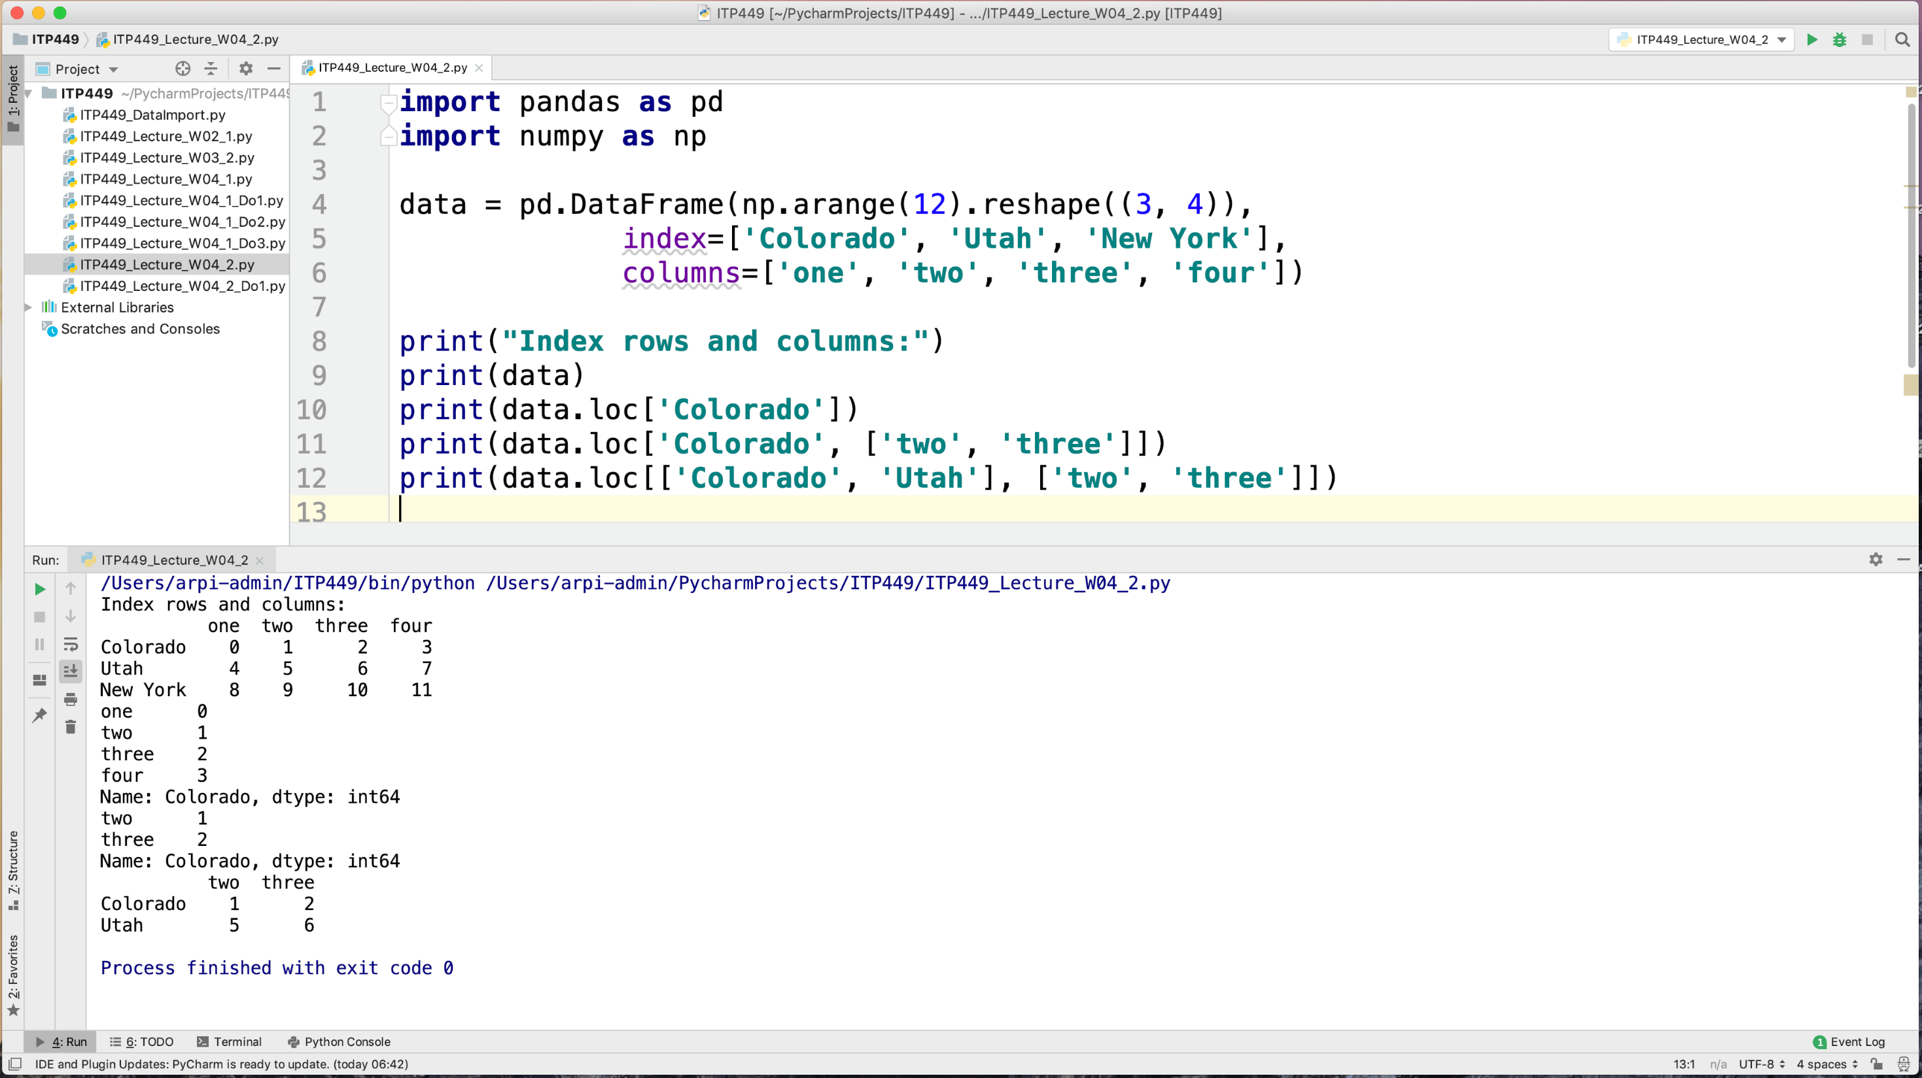
loc is label based location index
Used for label based indexing

Slide 30
Pandas Arithmetic

Slide 31
Functions for arithmetic
Function | Description
add | Addition (+)
sub | Subtraction (-)
div | Division (/)
mul | Multiplication (*)
pow | Exponentiation (**)

Slide 32
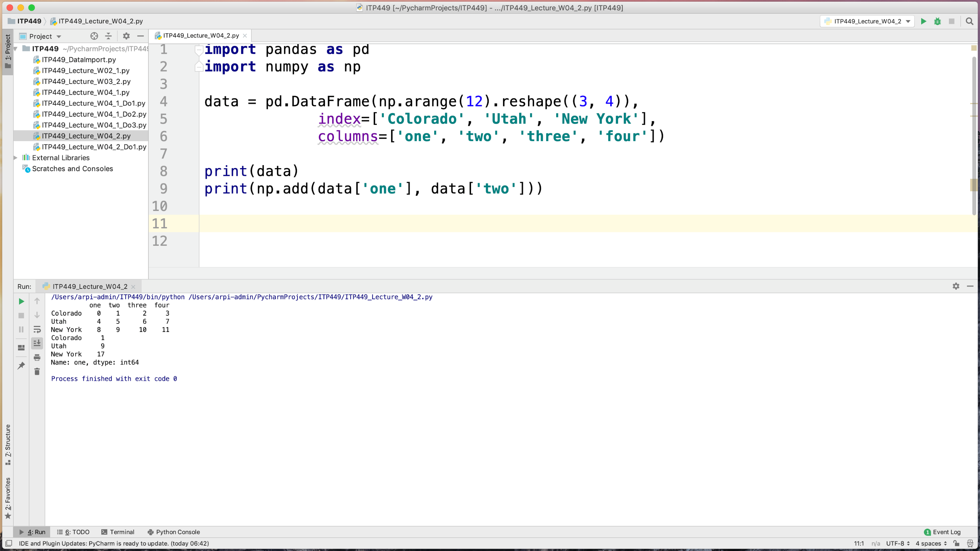

Slide 33
Sorting

Slide 34
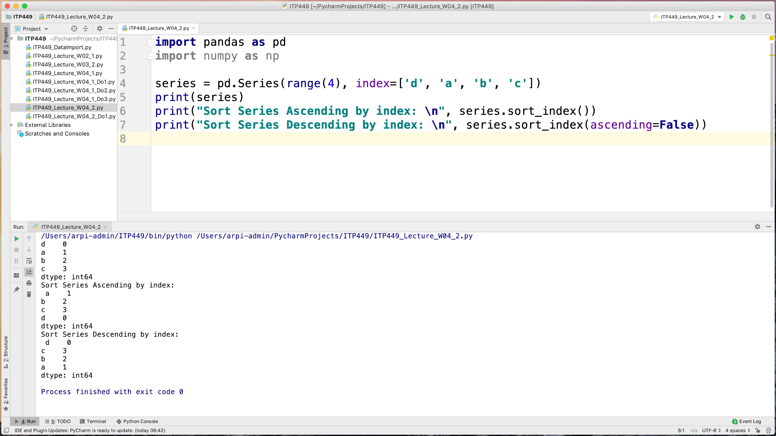

Slide 35
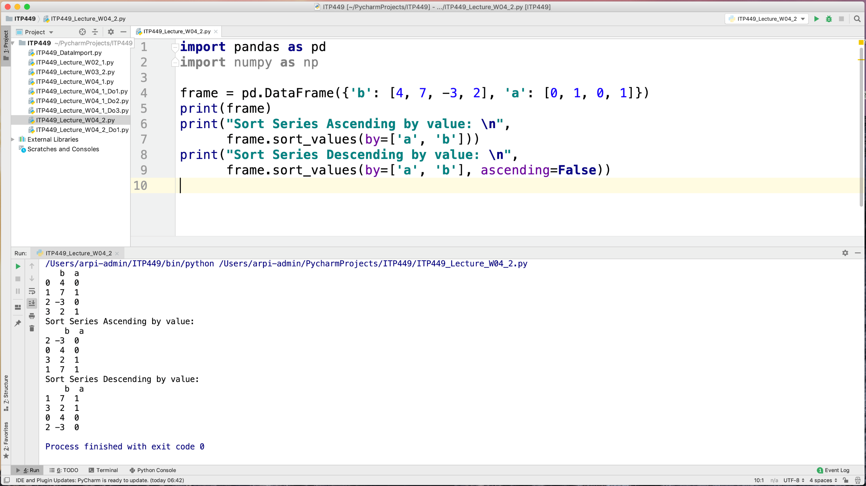
print(frame.sort_values(by=["a","b"],ascending=[True, False]))

Slide 36
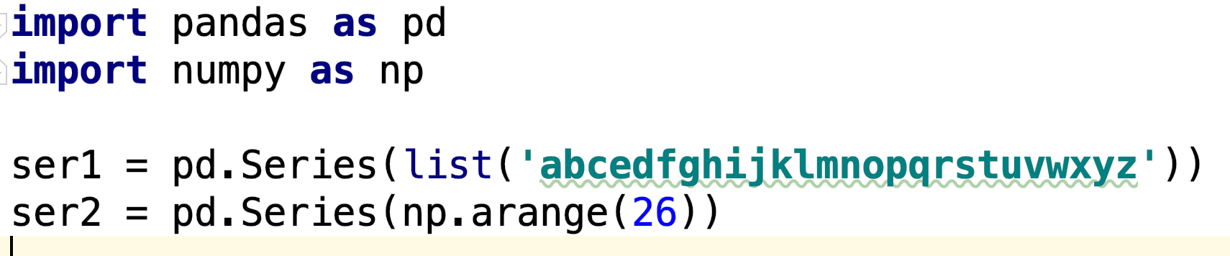
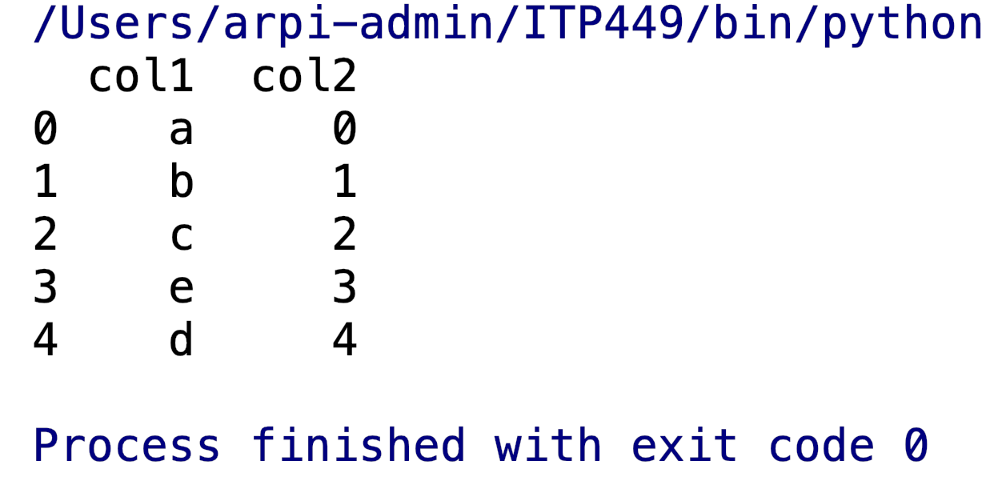
do the following:
Combine two Series to form a DataFrame

Slide 37
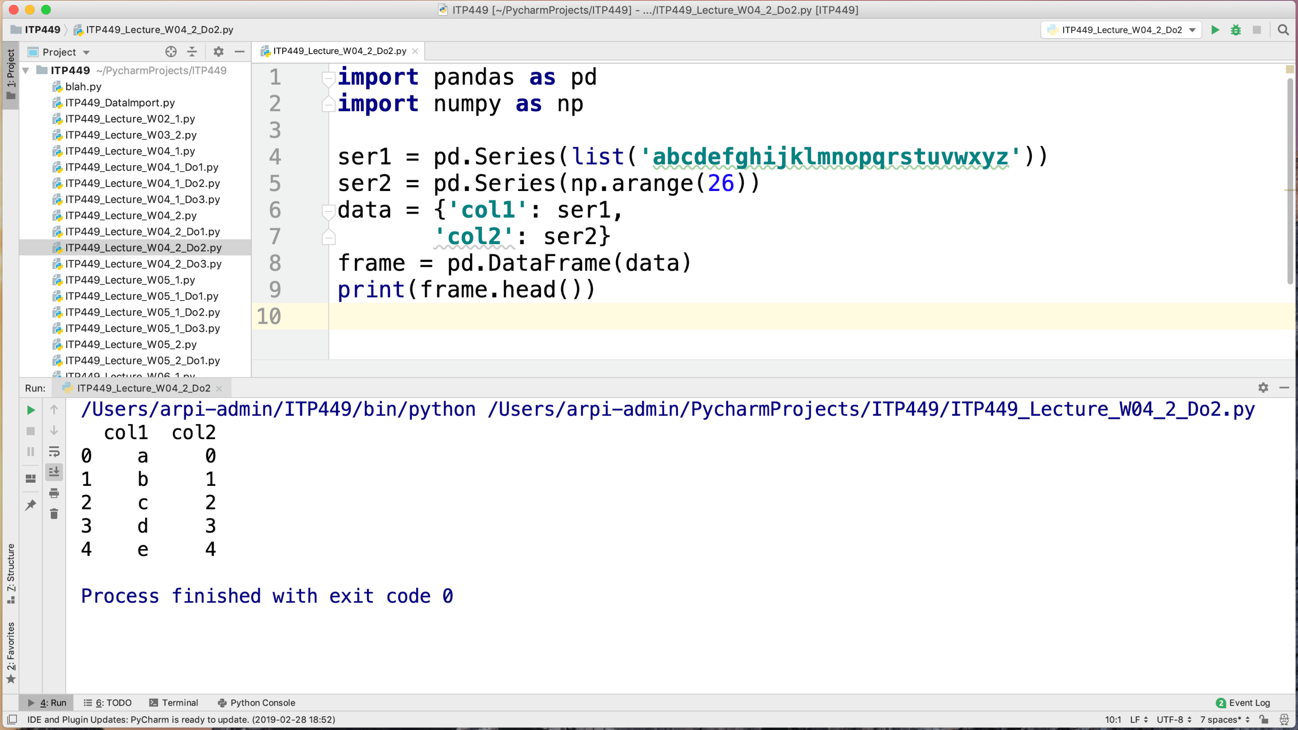

Slide 38
do the following:
Display the 25th, 50th and 75th percentiles for a Series containing 100 random numbers from the standard normal distribution.

Slide 39
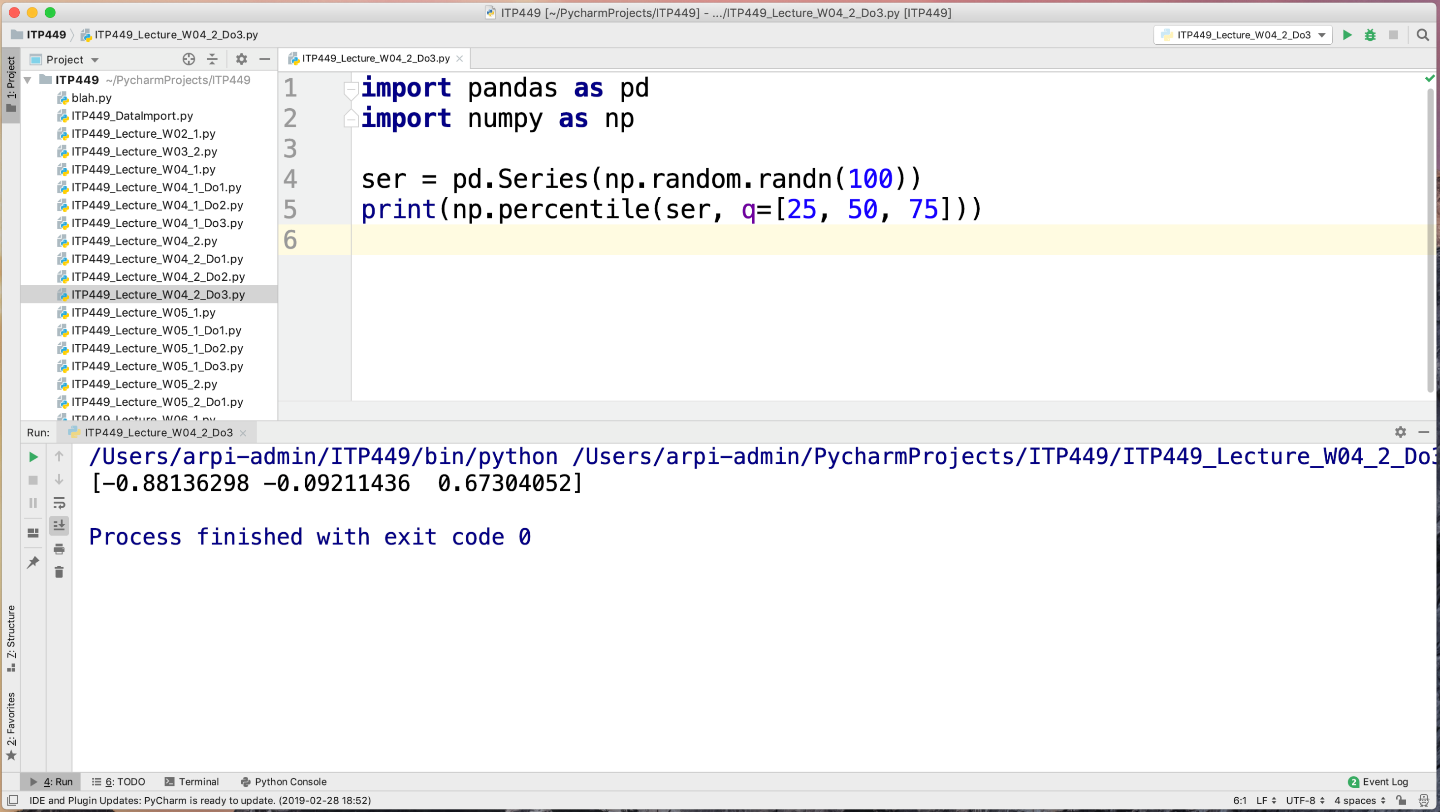

Slide 40
Pandas Visualization

Slide 41
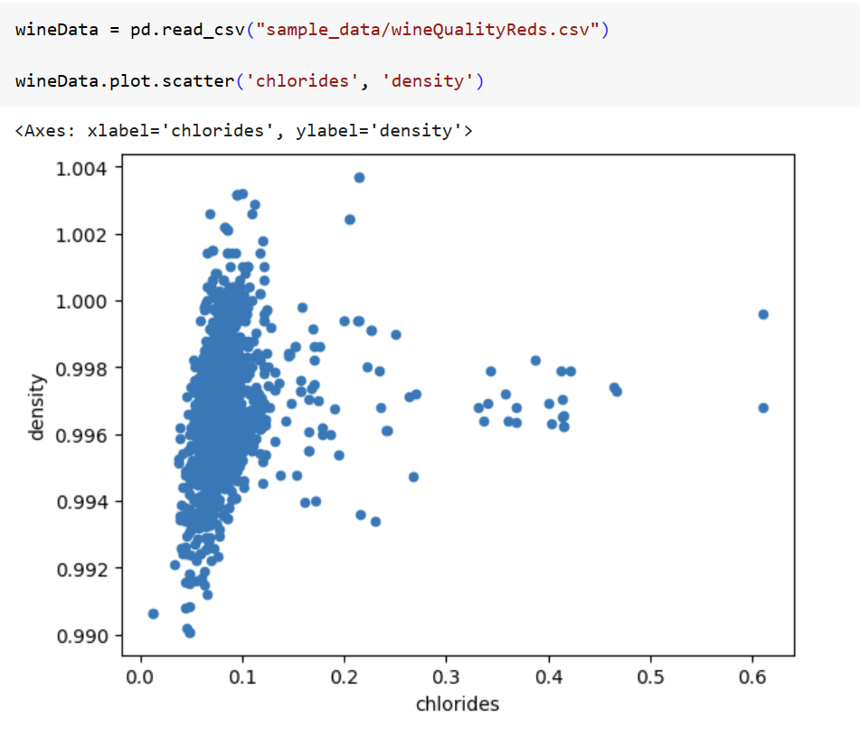
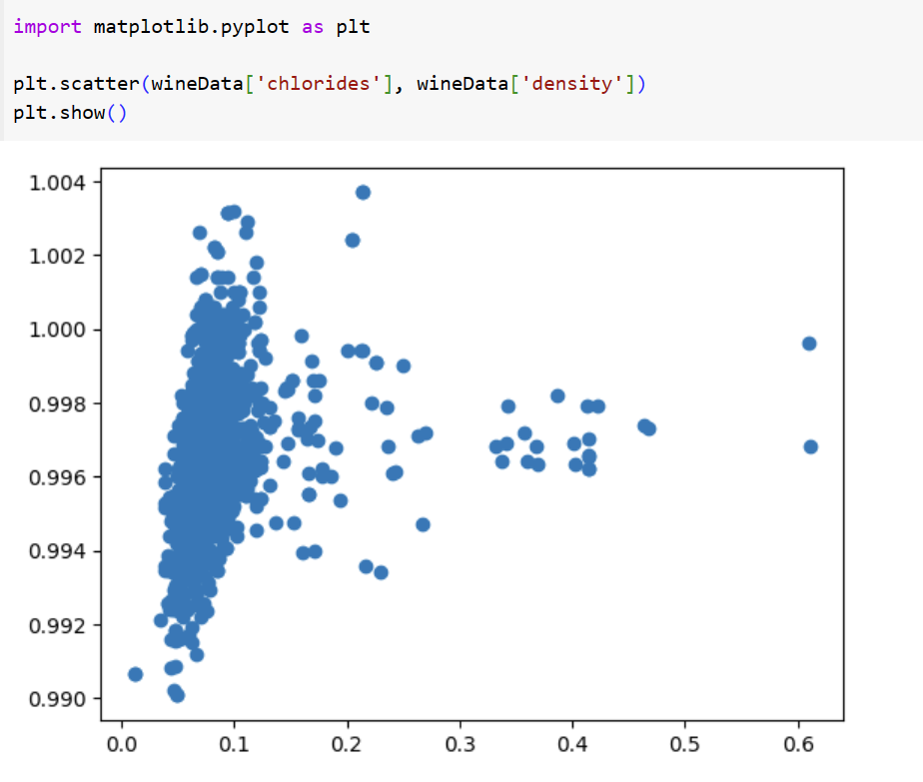
DataFrame have built-in visualization methods
We typically use matplotlib

Slide 42
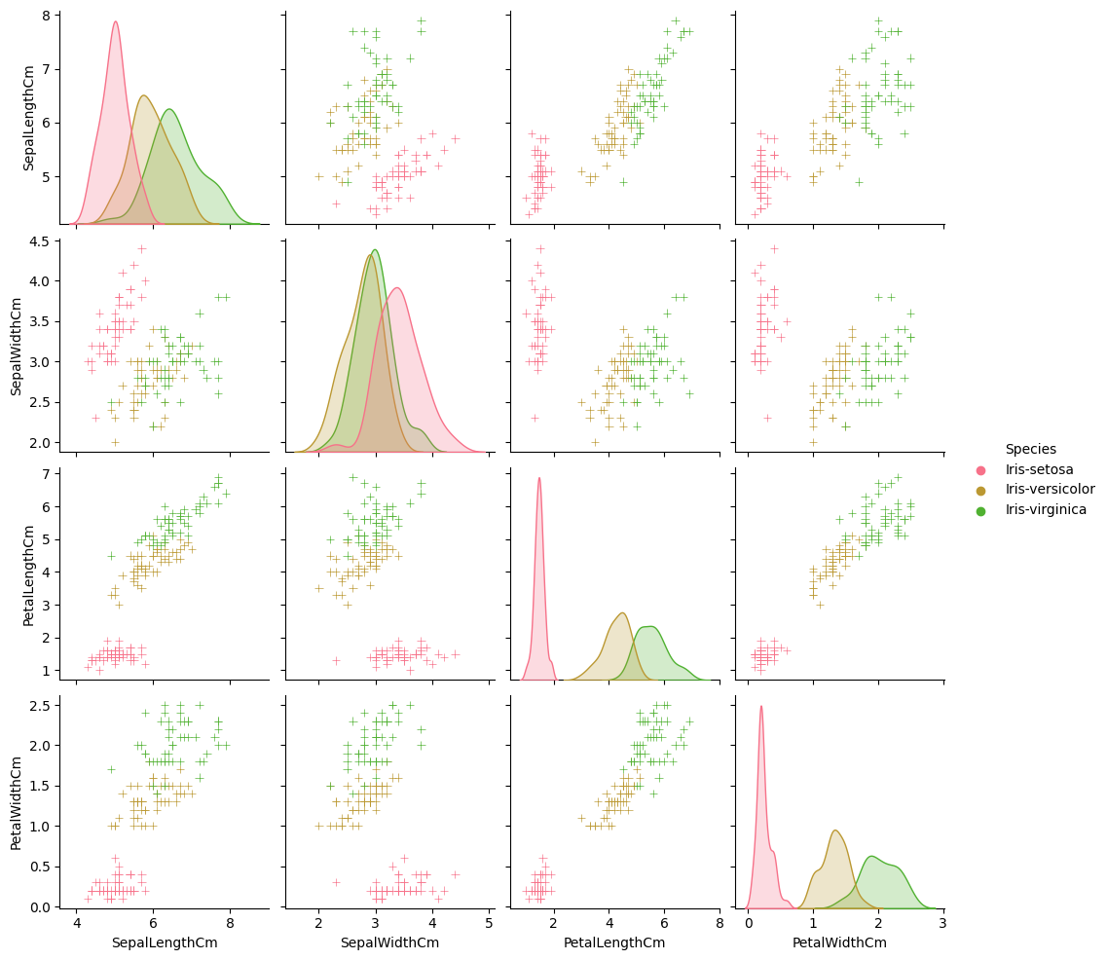
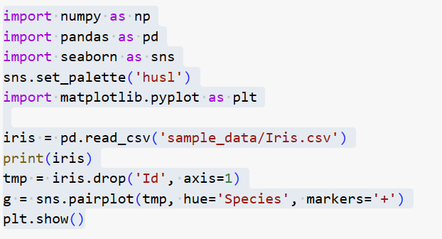
Seaborn visualization on Iris Data
Diagonal: probability distribution of the respective variable
Other boxes are pair plots

Slide 43
Summary
We will use dataframes this semester
Later, we will switch to tensors as our preferred data structure for AI

